Slide 1

Credit card fraud Detection Using Random Forest & Logistic Regression
.

Slide 2
Introduction
Credit card fraud is a significant issue that affects the banking and finance industry.
Fraudsters use various techniques to steal confidential information and carry out fraudulent transactions.
With the increasing number of digital transactions, the threat of credit card fraud has become even more prominent.
To address this problem, machine learning techniques like random forest and logistic regression can be used for fraud detection.

Slide 3
Objective
The objective of this project is to demonstrate the implementation of Random Forest and Logistic Regression models for credit card fraud detection.
We will explore the process of data preprocessing, visualizing class imbalance, synthesizing new data using SMOTE, splitting data into training and testing sets, and training and evaluating the performance of the models.
By the end of this project, will gain a practical understanding of the application of machine learning techniques to detect credit card fraud.

Slide 4
Data set & Methodology
Data Set Name: Fraudulent Transaction Prediction
Data set Link: https://www.kaggle.com/datasets/mlg-ulb/creditcardfraud
We have used the above-mentioned dataset which contains data collected by a German bank about transactions made on two days in September 2013.
The dataset contains 31 variables out of which 28 are PCA and mentioned as V1, V2, V3, …, V28.
The data is highly imbalanced with the fraud transactions comprising only 0.172% of the data. We use the SMOTE technique to over-sample the data and change the weightage of genuine and fraudulent transactions to 65% and 35% respectively.
Then we use the sample() function to decrease the time complexity of the project and randomly select 50000 data values from the SMOTE output.
We use these 50000 values as the dataset going ahead. We divide the data into training and testing model with the split ratio of 70%.
We have used the traincontrol function in the caret package to train the Random Forest and Logistic Regression models with the cross-validation method.
We have used the confusion matrix to evaluate these models.

Slide 5
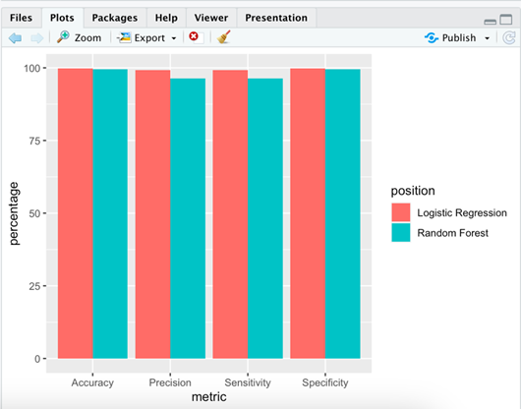
Results
Graph :
Confusion Matrix:
Comparison of the models: | Random Forest | Logistic Regression
Accuracy | 99.51% | 96.69%
Sensitivity | 99.82% | 99.18%
Specificity | 98.95% | 92.05%
Precision | 99.81% | 99.18%

Slide 6
Thank You !

